Slide 1
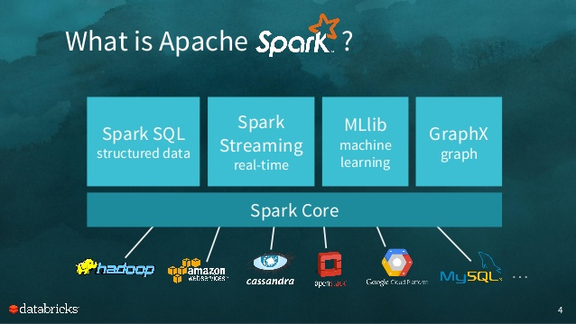
The Pilot Of Spark
2017.5
XenRon
http://spark.apache.org/docs/latest/

Slide 2

CONTENTS
01
Preliminary Topics
02
Spark Environment
03
Spark Architecture
04
Spark EcoSystem

Slide 3
Review
Review

Slide 4
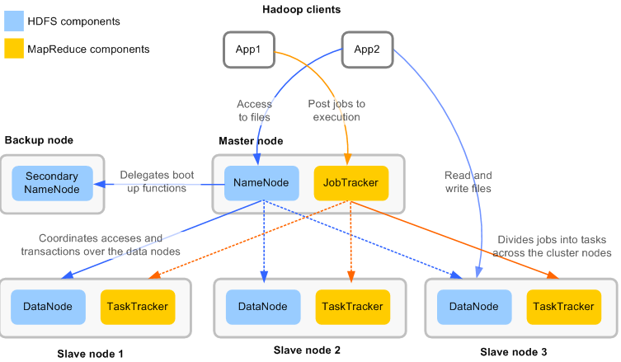
Map Reduce

Slide 5
HDFS

Slide 6
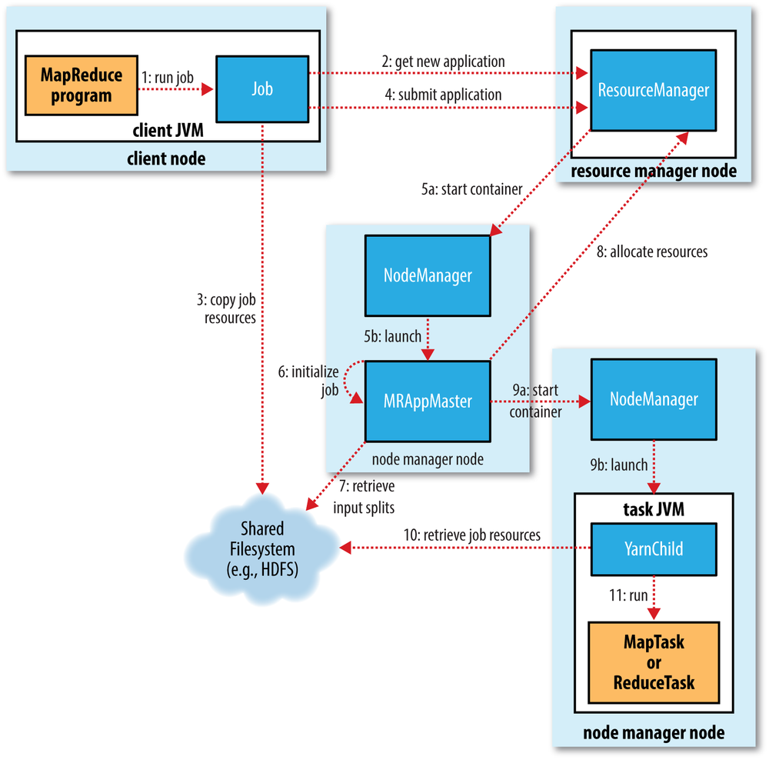
Map Reduce
Hadoop 2.x
Hadoop 1.x

Slide 7
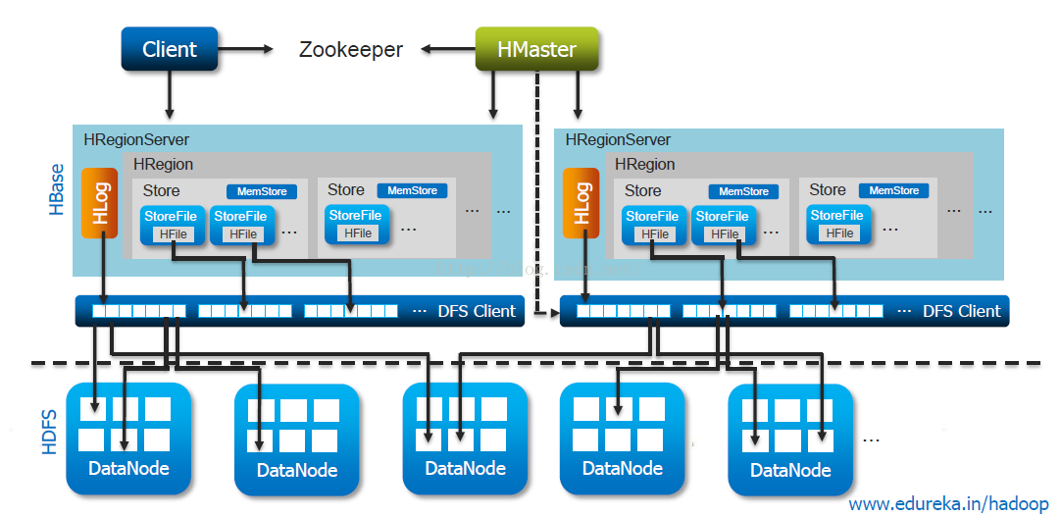
HBase

Slide 8
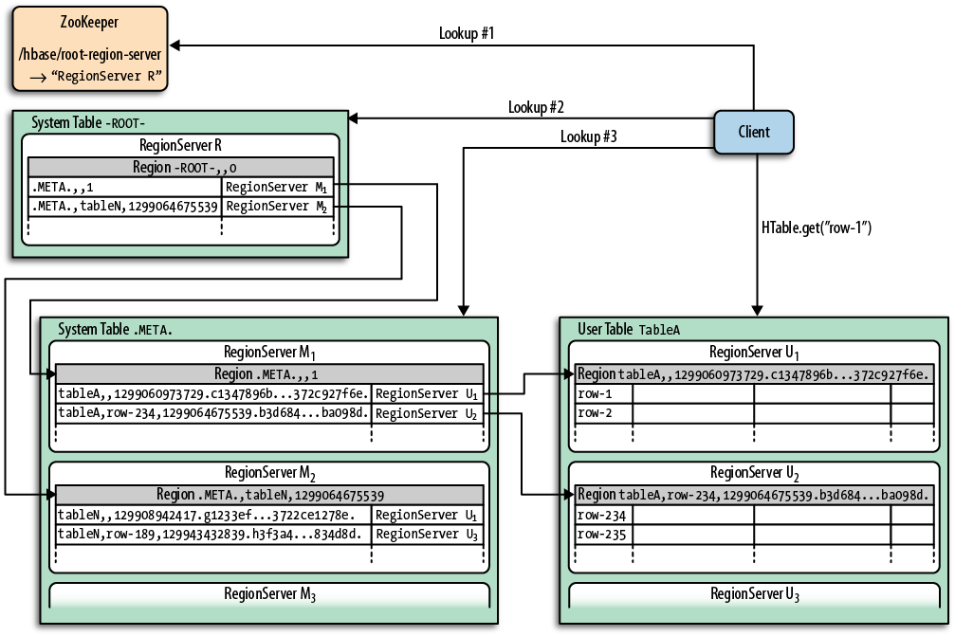
HBase

Slide 9
PART1
Preliminary Topics
事前準備

Slide 10
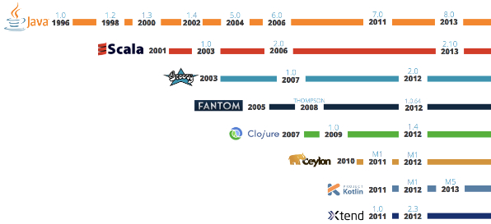
JVM

Slide 11
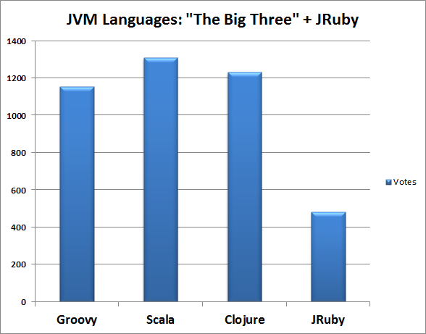
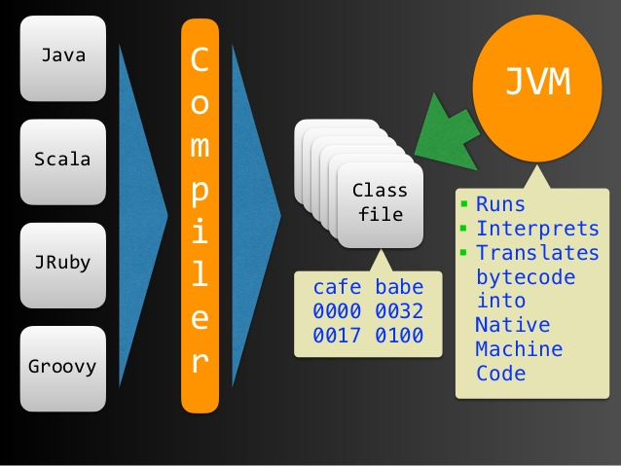
Big Three

Slide 12
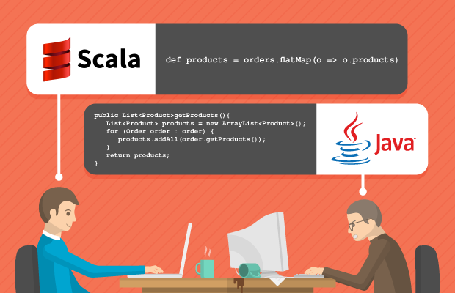
Scala

Slide 13
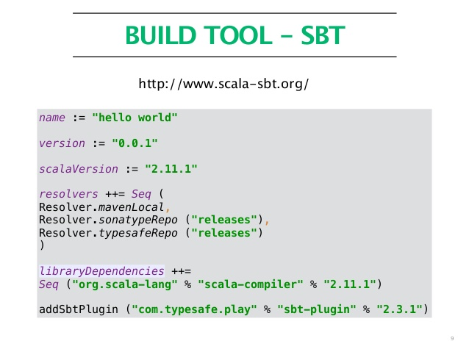
Sbt

Slide 14
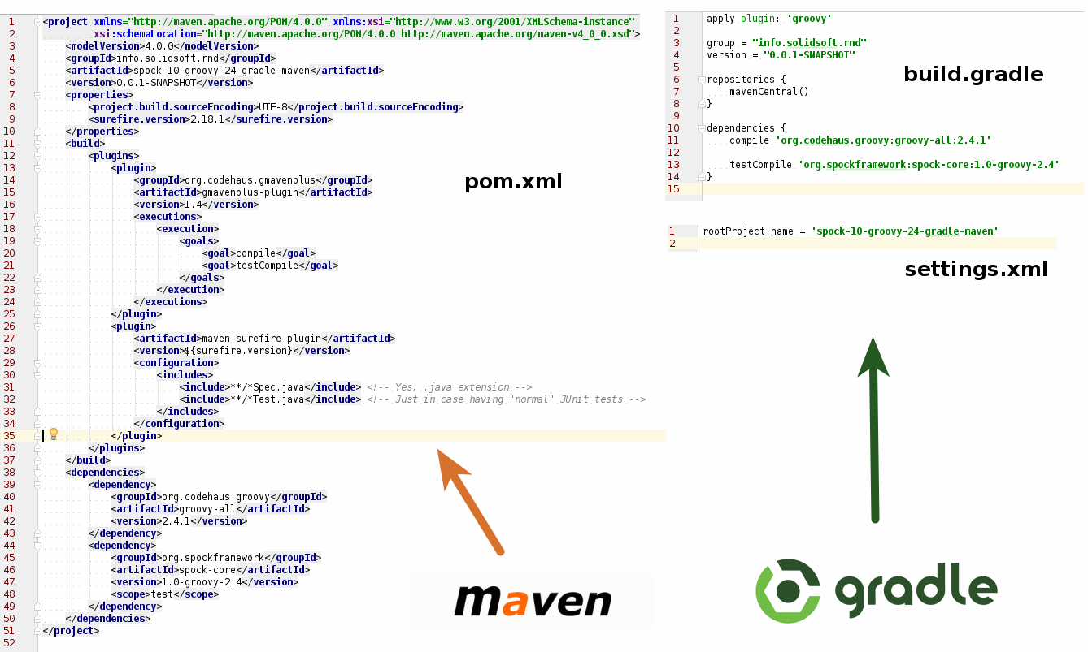
Sbt

Slide 15
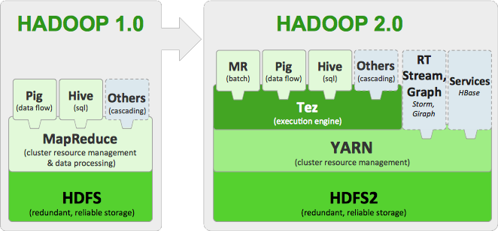
Yarn

Slide 16
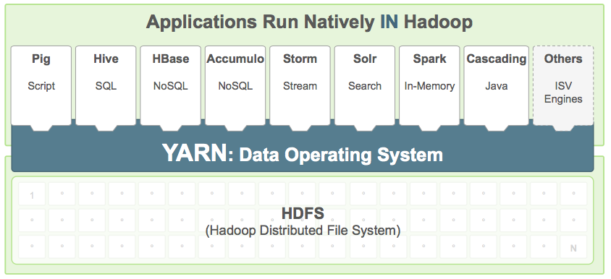
Yarn

Slide 17
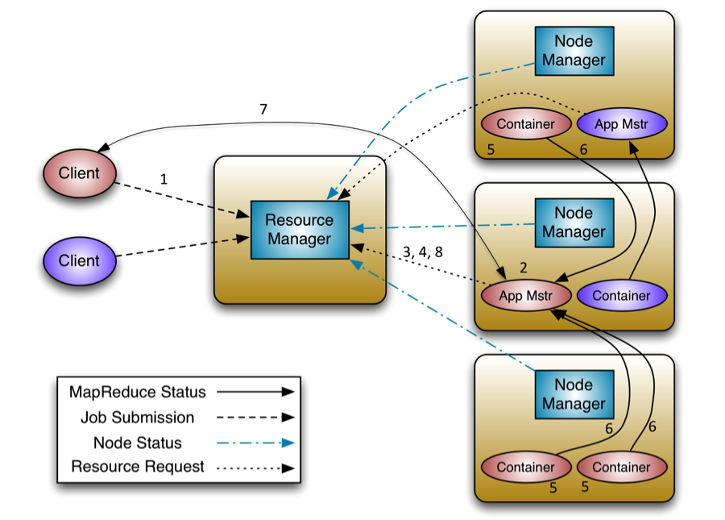
Yarn
https://hadoop.apache.org/docs/stable/hadoop-yarn/hadoop-yarn-site/WritingYarnApplications.html

Slide 18
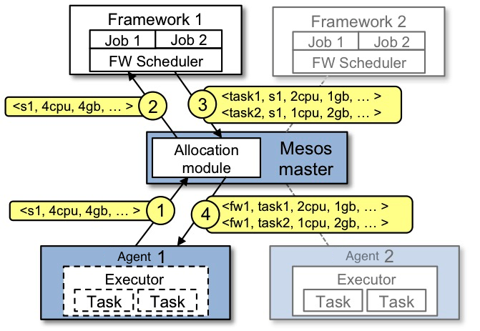
Mesos

Slide 19
PART2
Spark Environment

Slide 20
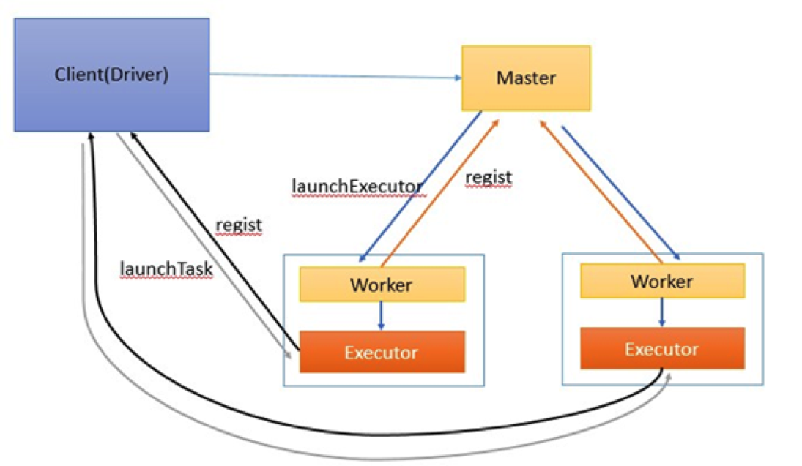
Spark Standalone

Slide 21
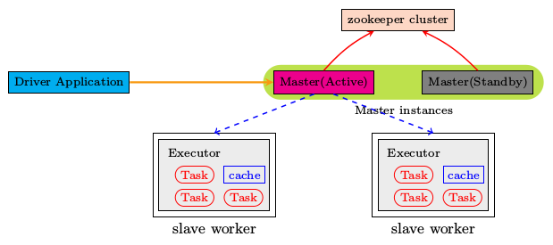
Spark Standalone HA

Slide 22
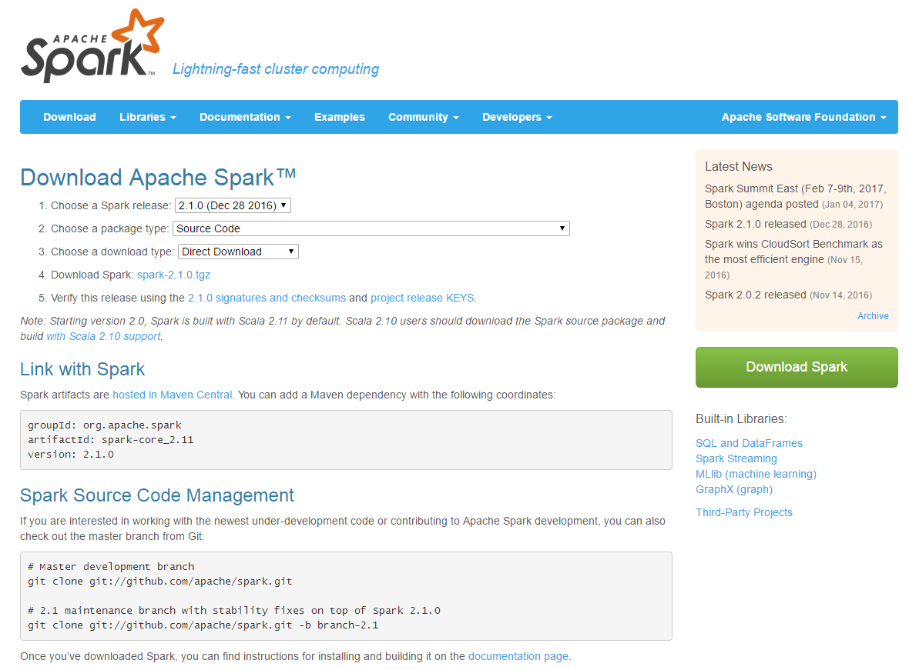
Spark Source Compile

Slide 23
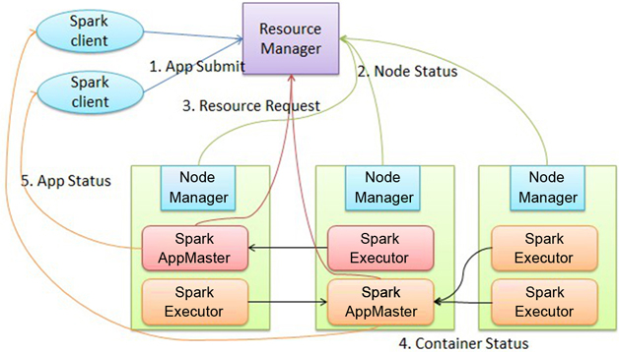
Spark On Yarn

Slide 24
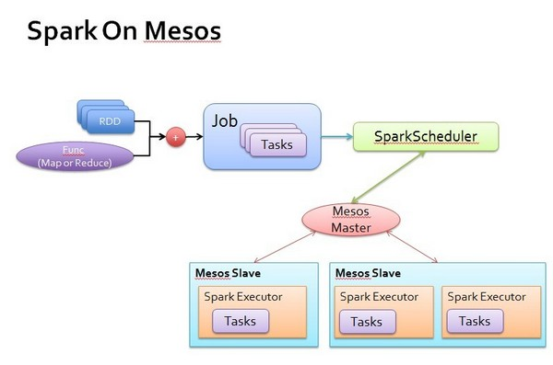
Spark On Mesos

Slide 25
PART3
Spark Architecture

Slide 26
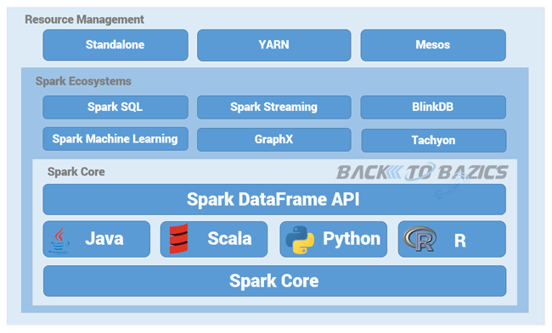
Ecosystems

Slide 27
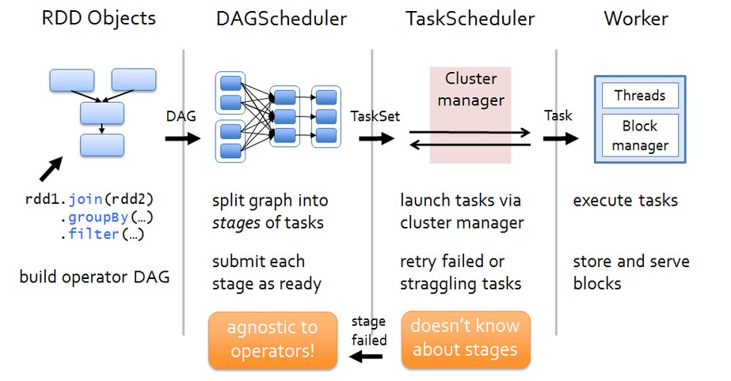
Architecture

Slide 28
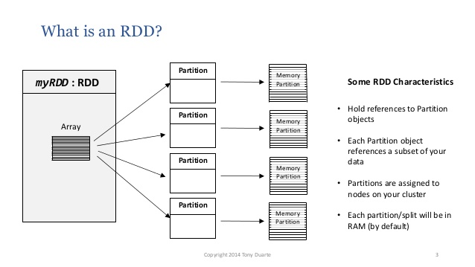
RDD

Slide 29
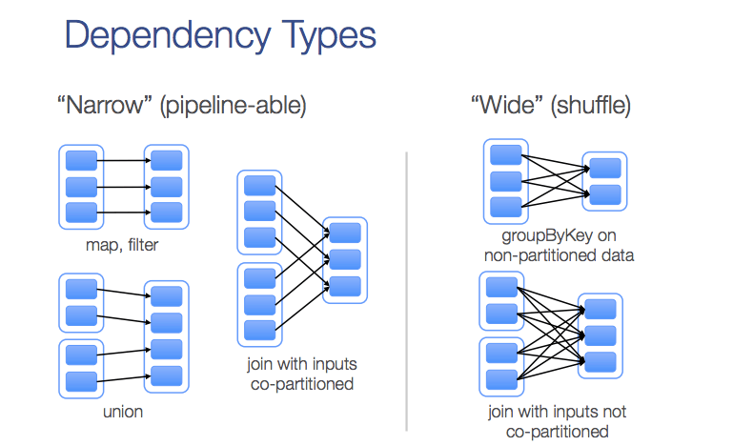
Dependency Type

Slide 30
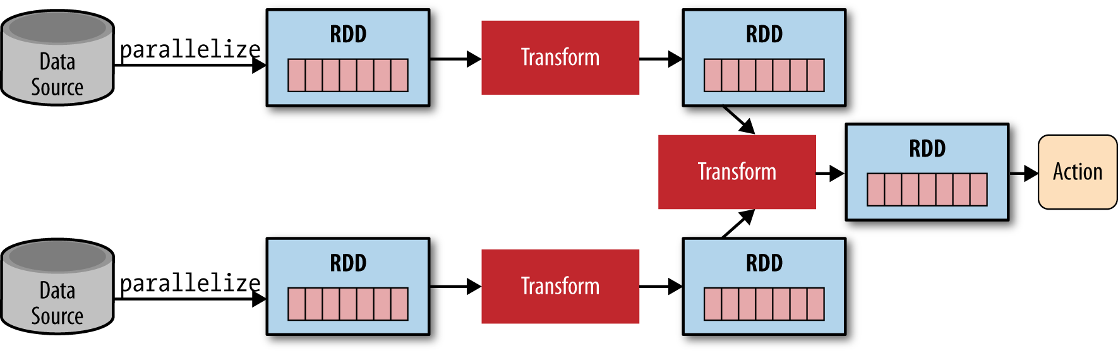
Dependency Type

Slide 31
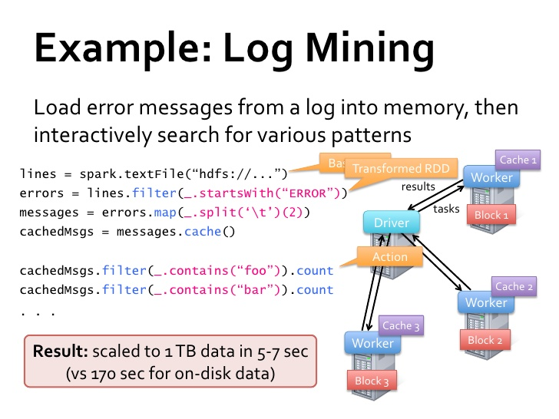
Example

Slide 32
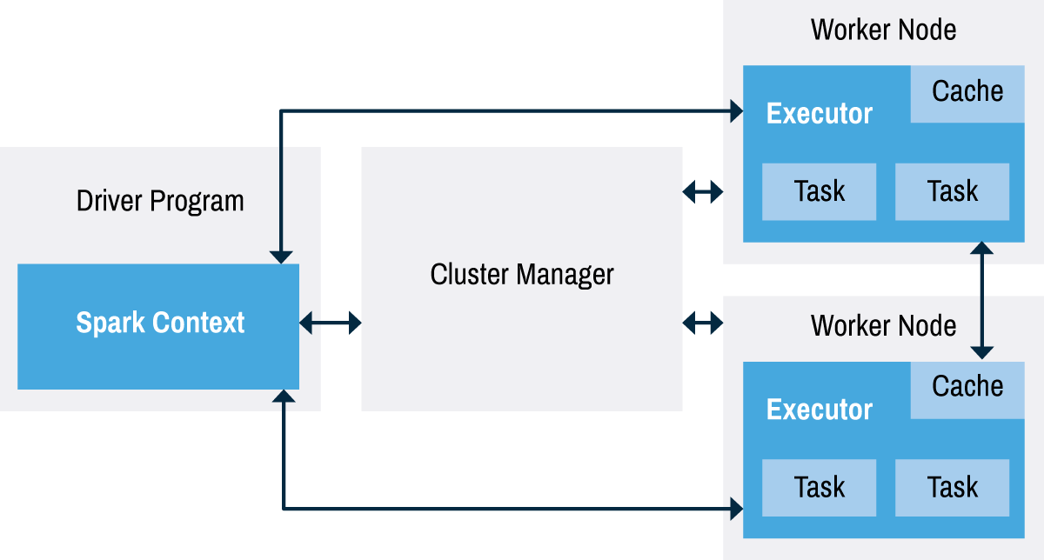
Driver
Executor
Application

Slide 33
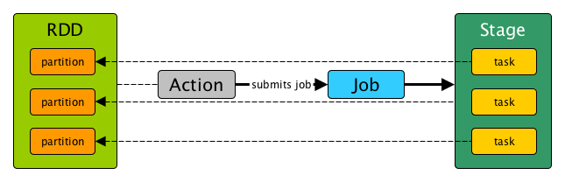
Job

Slide 34
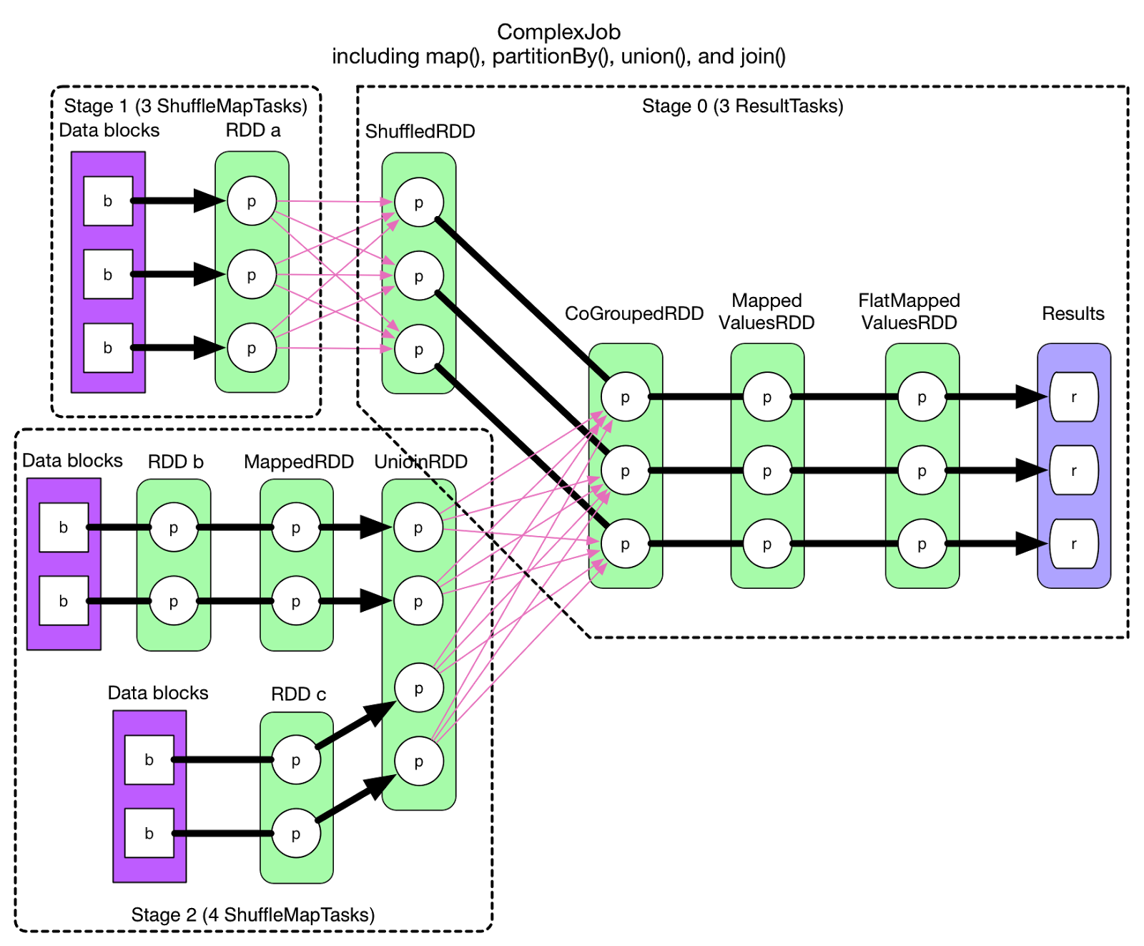
Stage

Slide 35
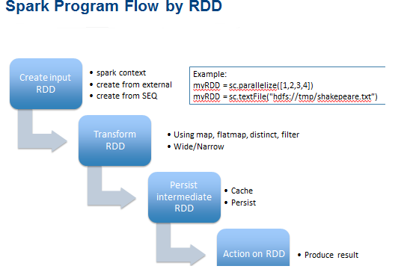
Persist & Cache

Slide 36
PART4
Spark SQL

Slide 37
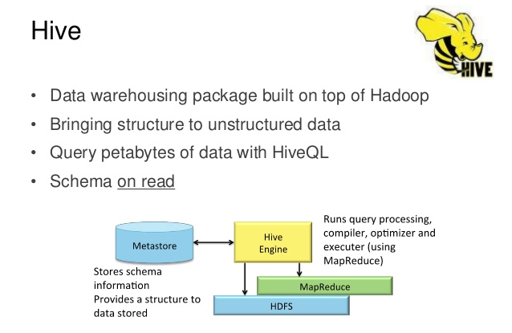
Hive

Slide 38
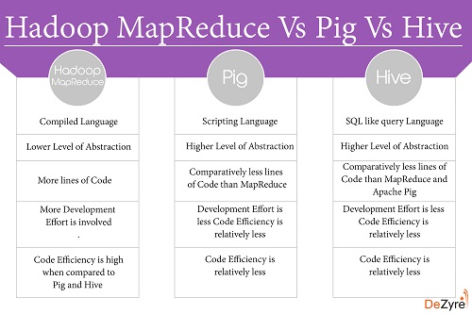
Hive

Slide 39
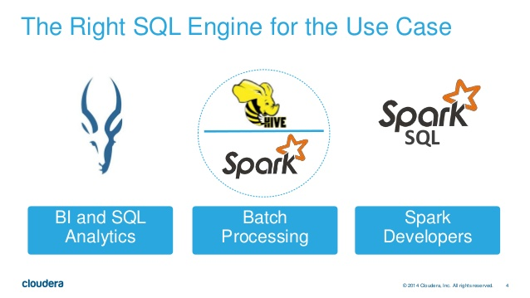
Spark SQL

Slide 40
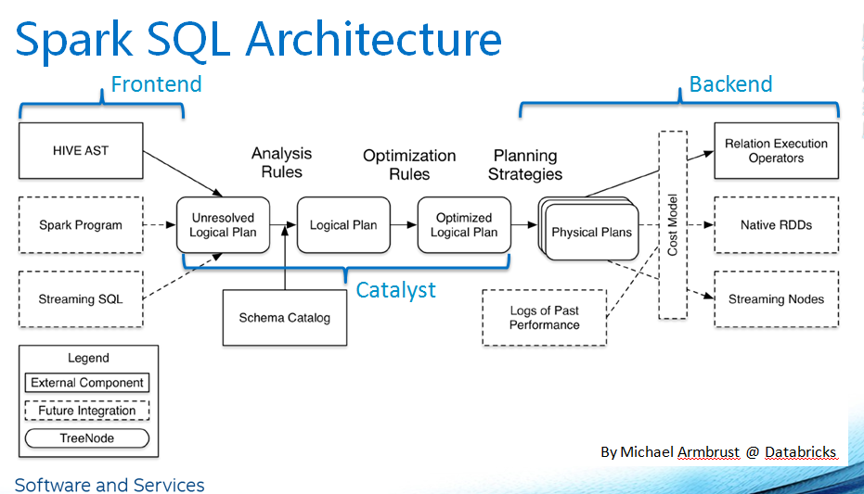
Spark SQL

Slide 41
PART5
Spark Streaming

Slide 42
Ecosystems

Slide 43
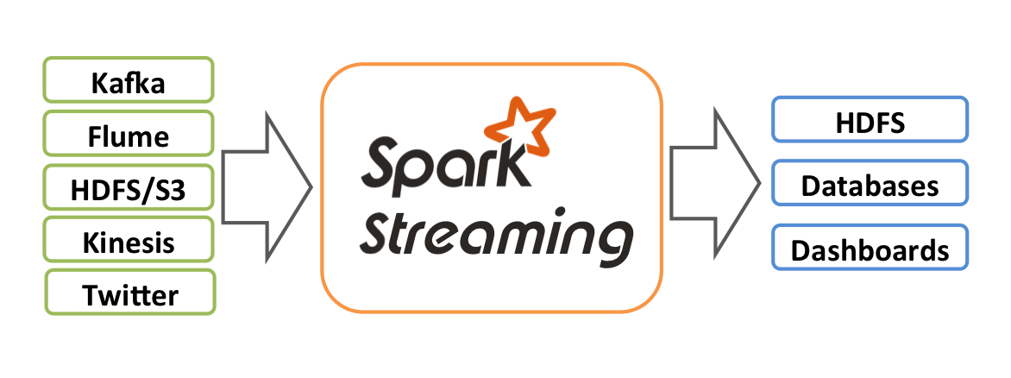
Spark Streaming

Slide 44
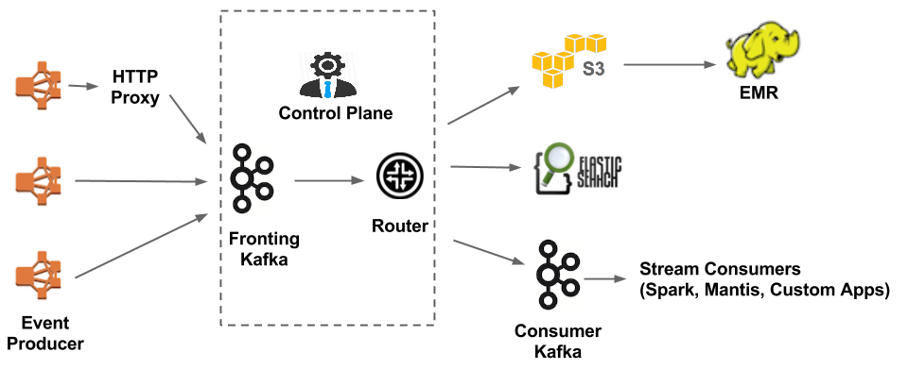
Kafka

Slide 45
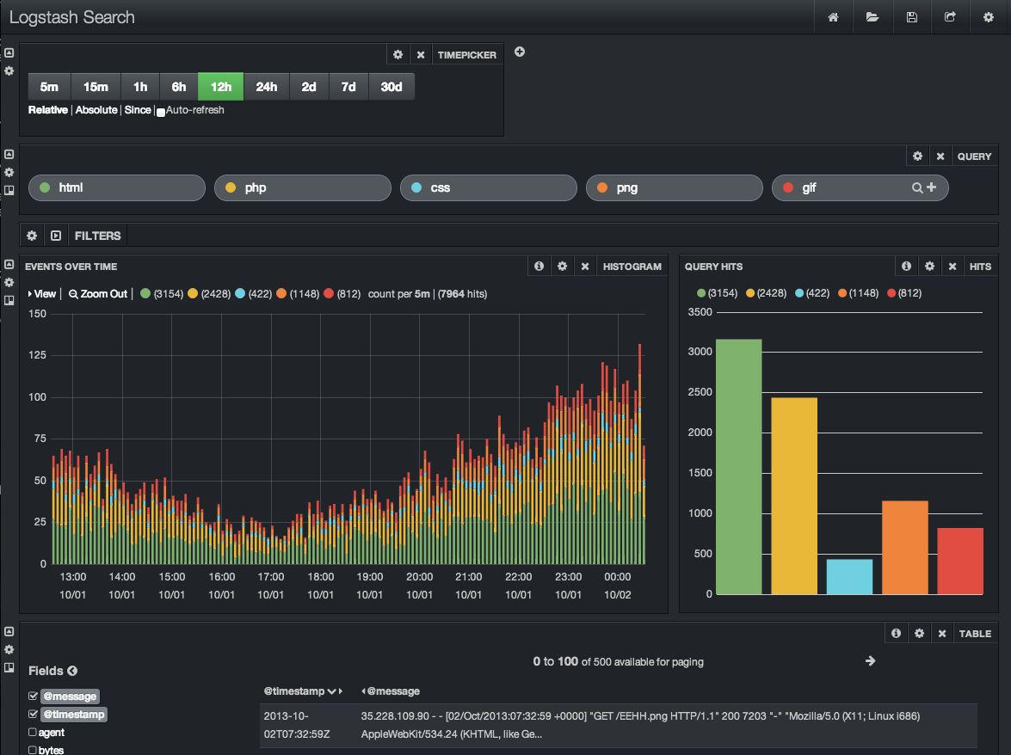
ELK (ElasticSearch LogStash Kibana)

Slide 46

Search Engine

Slide 47
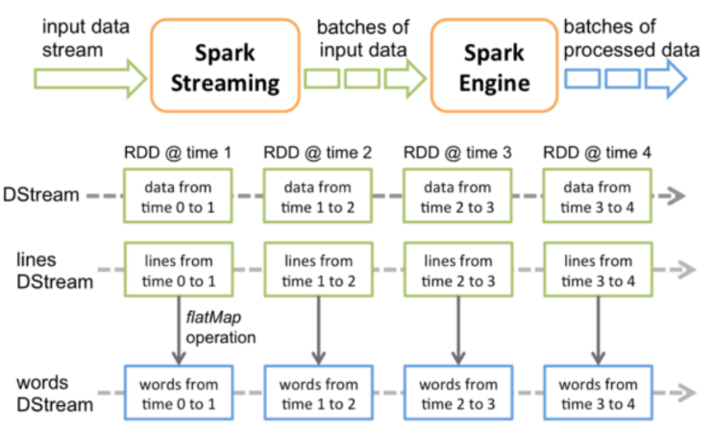
Spark Streaming

Slide 48
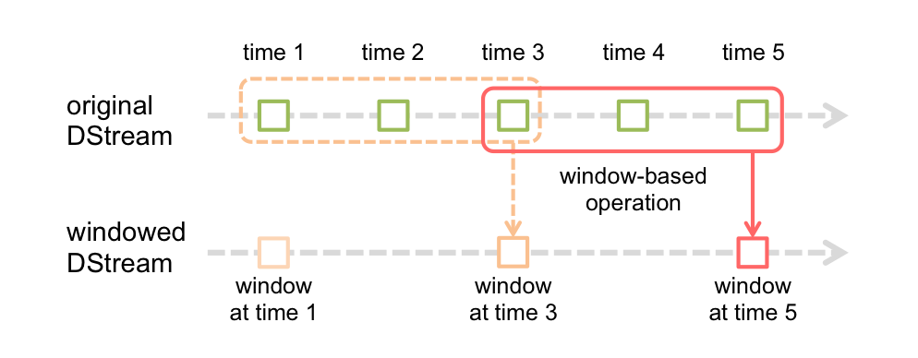
Windows based operations

Slide 49
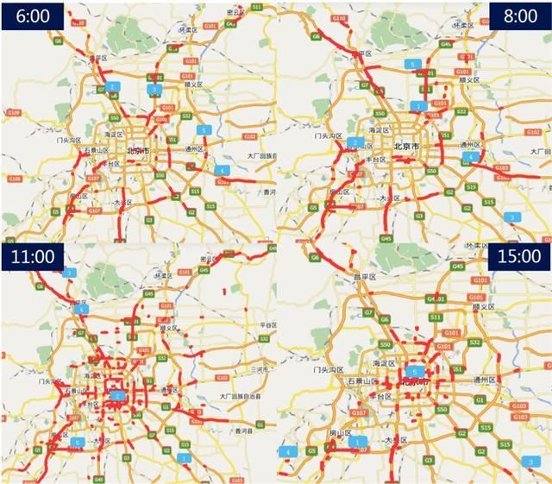
Real-Time Traffic

Slide 50
PART6
Spark Machine Learning

Slide 51
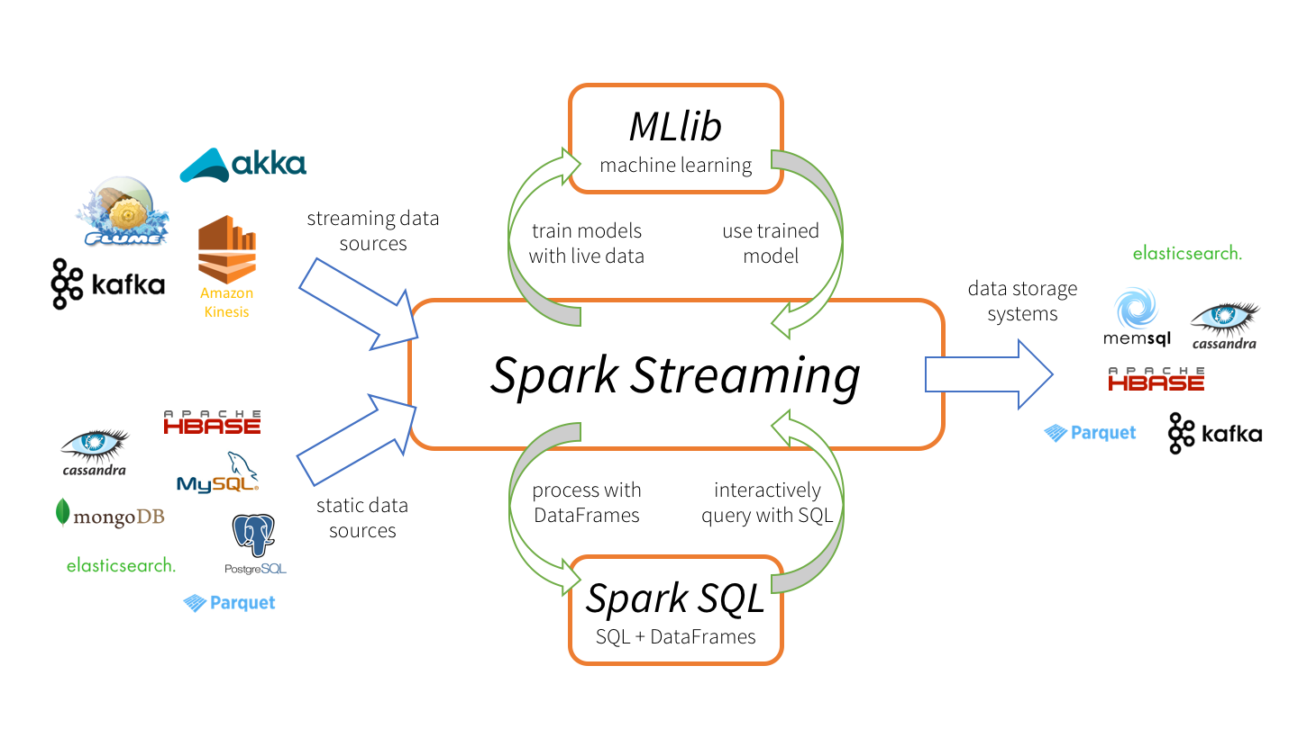
Ecosystems

Slide 52
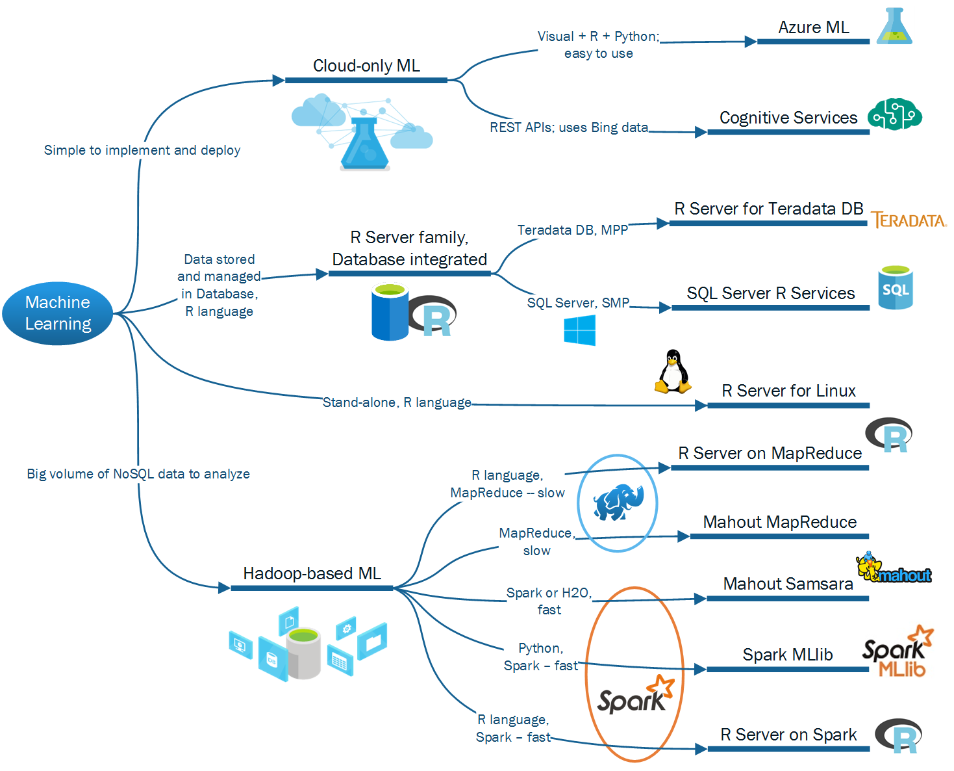
Ecosystems

Slide 53
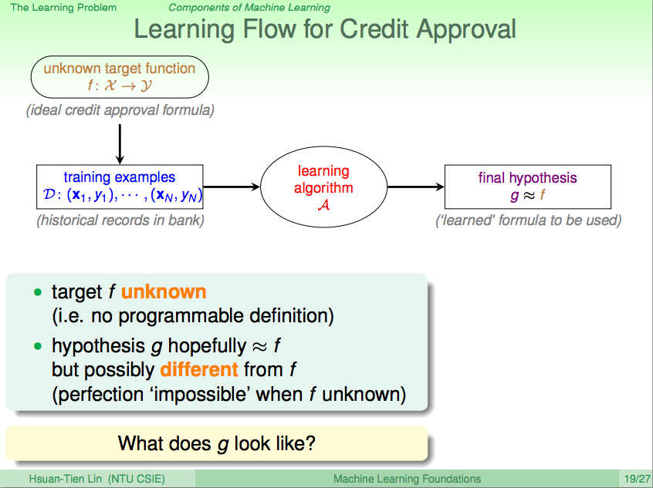
Use Case : Credit Approval

Slide 54


Use Case : WeChat

Slide 55


Use Case : Hatsune Miku Upscale

Slide 56
PART7
Spark GraphX

Slide 57
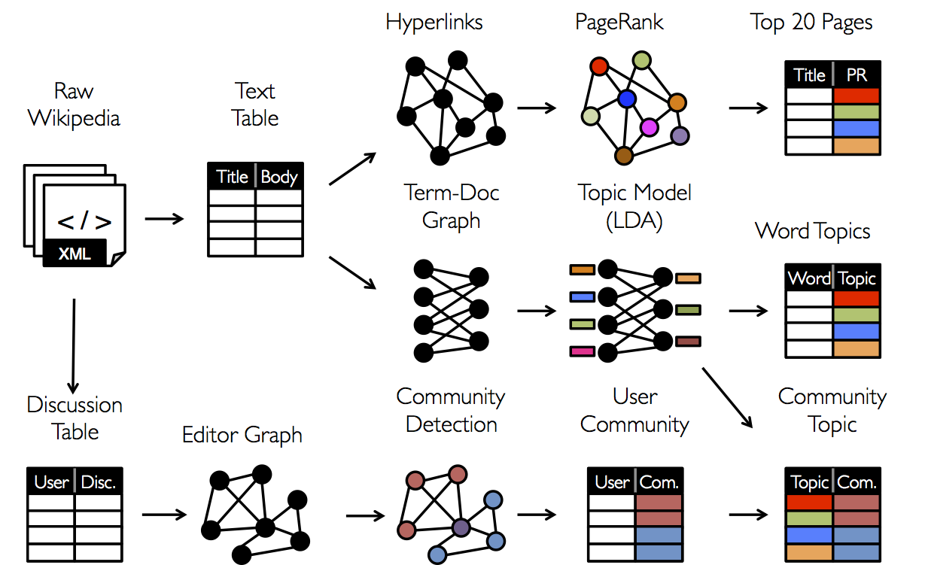
GraphX

Slide 58
Weibo

Slide 59
Social Network Site community

Slide 60
The End

